Slide 1

Sorting Rows
Version 1.5

Slide 2
Overview
ORDER BY clause
Sort order
Sort on multiple columns
Sort on expressions
Eliminate duplicates - DISTINCT
Limit results - TOP
Hands-on lab

Slide 3
OBJECTIVES
At the end of this module you will be able to:
write a query that sorts on a single column
write a query that sorts on multiple columns
write a query that sorts on a calculated column
write a query that selects unique values
write a query that returns only a specified number of rows

Slide 4
ORDER BY clause

Slide 5
ORDER BY clause
SELECT <<field(s)>>
FROM <<table(s)>>
WHERE <<condition(s)>>
GROUP BY <<field(s)>>
HAVING <<condition(s)>>
ORDER BY <<field(s)>>
Notes:
The optional ORDER BY clause is how we tell SQL to sort the results. Its position, right at the end of the select statement, is accurate.
Sorting is the very last thing to happen to our result set. All the filtering and calculating and manipulating has been done by the time SQL gets around to sorting the data, because sorting can be very time-consuming; imagine if SQL sorted a million rows from a table before realising that none of the rows meet the WHERE clause!

Slide 6
Sort order

Slide 7
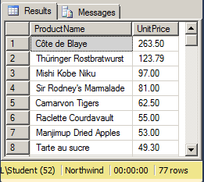
Sort order
ASC – ascending
Default
DESC – descending
SELECT ProductName, UnitPrice FROM dbo.Products ORDER BY UnitPrice DESC
Notes:
If we do not specify an ORDER BY clause, SQL does not guarantee the order in which rows will be returned.
The default sorting rules (“collation settings”) for text (language, case sensitivity, accent sensitivity) will have been set up when the server was installed. Usually, in the UK, they are case insensitive and follow the rules of English. Individual databases, tables and even columns can be given alternative collations.
By default, columns are sorted in ascending order (1 to 10, a to z, etc.) but it is possible to tell SQL to sort them in descending order (10 to 1, z to a and so on) using the DESC keyword. There is also an ASC keyword but it doesn’t tend to get used very often...

Slide 8
Sort on multiple columns

Slide 9
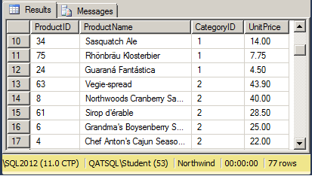
Sort on multiple columns
Up to 16 columns in ORDER BY clause
Sort columns do not have to be included in select list
SELECT ProductID, ProductName, CategoryID, UnitPrice FROM dbo.Products ORDER BY CategoryID, UnitPrice DESC
Notes:
We can sort on up to sixteen columns in one ORDER BY clause, using a comma-separated list of column names.
The columns that we’re sorting on do not have to be in the list of columns we’re selecting out, but it can be confusing for us humans if the sort order isn’t obvious. Imagine if the example on the slide didn’t include the CategoryId column in the select list – it would be difficult to understand why the results were in that order.

Slide 10
Sort on expressions

Slide 11
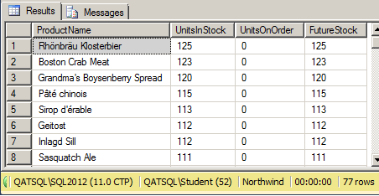
Sort on expressions
ORDER BY
<<expression>>
<<expression-alias>>
<<expression-ordinal>>
SELECT ProductName, UnitsInStock, UnitsOnOrder, UnitsInStock + UnitsOnOrder AS FutureStock FROM dbo.Products ORDER BY FutureStock DESC
Notes:
We are not restricted to just columns; we can sort on calculated values as well.
Unlike filtering on expressions, we do not have to duplicate the expression in the ORDER BY clause. Remember, sorting is the very last thing to happen, after all of the rows have been selected and most importantly after all the expressions have been evaluated.
We can use the column alias if there is one or the expression’s ordinal number if not.
In fact, we can use column ordinals – column numbers relating to their position from left to right in the result set - to sort on any column, calculated or not, but this is not considered best practice. Firstly, queries using ordinals can be more confusing to read – which column name does “ORDER BY 17” refer to? – plus if you modify the SELECT list your query may no longer return the data sorted in the order you require, or may even return an error, unless you modify the number in the ORDER BY clause.

Slide 12
Eliminate duplicates – DISTINCT

Slide 13
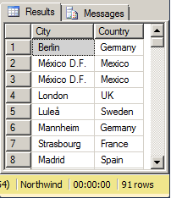
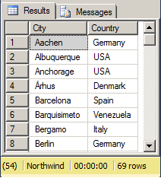
Eliminate duplicates – SELECT DISTINCT
SELECT City, Country FROM dbo.Customers
SELECT DISTINCT City, Country FROM dbo.Customers
Notes:
If we require a list of unique values, we can use the DISTINCT modifier on our SELECT statement to eliminate duplicates. The reason this is being mentioned during the sorting chapter is that SQL usually needs to sort the data to be able to find duplicates. The check for duplicate data is based on all the values in the select list, so a
SELECT DISTINCT CompanyName, City FROM dbo.Customers
would be a fairly pointless exercise in the Northwind database because every customer only appears once in the customers table. If we just wanted to see which customers have at least one address in a given city, then it might make sense. As in:
SELECT DISTINCT CompanyName, City FROM dbo.Customers
WHERE City = ‘London’

Slide 14
Limit results – TOP

Slide 15
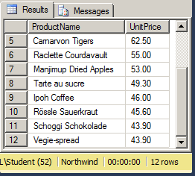
Limit results – SELECT TOP
SELECT TOP n
SELECT TOP n PERCENT
SELECT TOP n … WITH TIES
SELECT TOP 11 WITH TIES ProductName, UnitPrice FROM dbo.Products ORDER BY UnitPrice DESC
Notes:
We might only want to see a few of the possible rows returned, especially with a sorted query.
SELECT TOP n enables us to answer questions like “what are our 10 most expensive products”. We can order our results by price descending and then select just the top 10 results.
We can also specify a percentage of the available rows, so 10% of the rows in a table with 77 rows would give us back 8 rows (the .7 of a row is rounded up).
Finally, we can specify the WITH TIES option, which tells SQL to return all the rows that are tied for “last place”. Note that WITH TIES requires an ORDER BY clause to work.
It is best practice to only ever use a TOP in conjunction with an ORDER BY clause. This is the only way to predictably indicate which rows are affected by TOP.
Since SQL 2012, if you want to implement a paging solution, the new keyword combination of OFFSET and FETCH should be used. As in:
SELECT ProductName, UnitPrice FROM dbo.Products ORDER BY UnitPrice DESC
OFFSET 0 ROWS FETCH NEXT 10 ROWS ONLY
Then, to return the next 10 rows the following would be used:
SELECT ProductName, UnitPrice FROM dbo.Products ORDER BY UnitPrice DESC
OFFSET 10 ROWS FETCH NEXT 10 ROWS ONLY

Slide 16
Hands-on lab
Basic sorting
Sorting on expressions
Unique rows
Limiting results

Slide 17
Review
ORDER BY clause
Sorting on columns
Sort orders
Selecting unique rows
Limiting results

